Slide 1
Async/Await in JavaScript
Ananth Subramanian
February 01, 2018

Slide 2
Disclaimer
The following presentation is based off of the series of articles called Asynchronous Adventures in JavaScript by Benjamin Diuguid in Medium/DailyJS group.
Benjamin Diuguid is a Software Engineer at Google.
Google, huh? So, he should know what he is talking about. I believe, he does.

Slide 3
How Did We Get To Async/Await?
Event Loop
Callback
Promises
Async/Await

Slide 4
Understanding The Event Loop
Call Stack
Web / Node APIs
Event Loop (There it is)
Callback queue
Notes:
Call Stack – when a function is called it is pushed, when a function returns the call is popped.
Web API – multi threaded, mainly process the asynchronous functions
Event loop – has only one job. Checks call stack if it is empty and check the callback queue if there are any callbacks pending. If there are any dequeues the first callback and pushes it to the stack.
Callback queue – Self explanatory. The web/node API enqueues callback functions after an asynchronous action is complete.

Slide 5
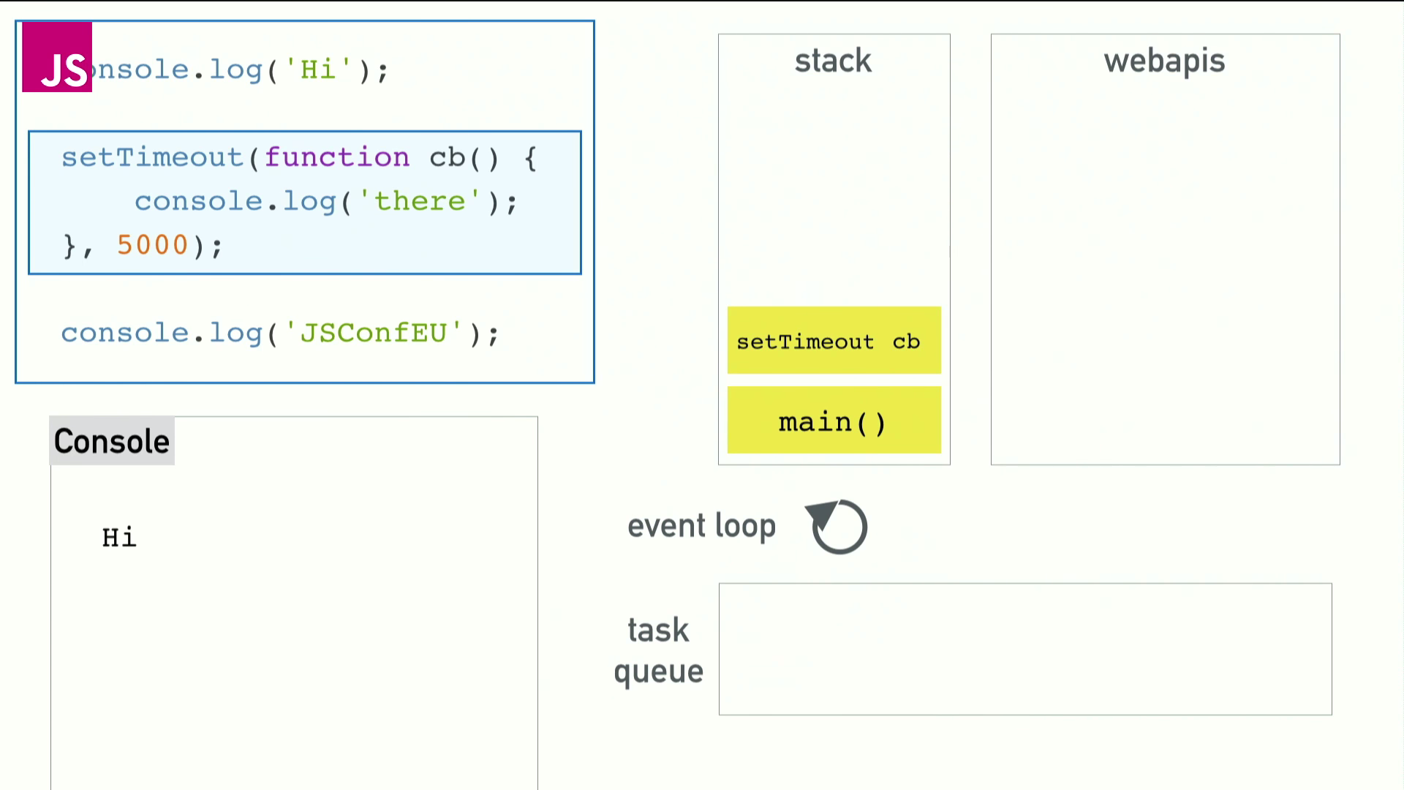
Call Stack

Slide 6
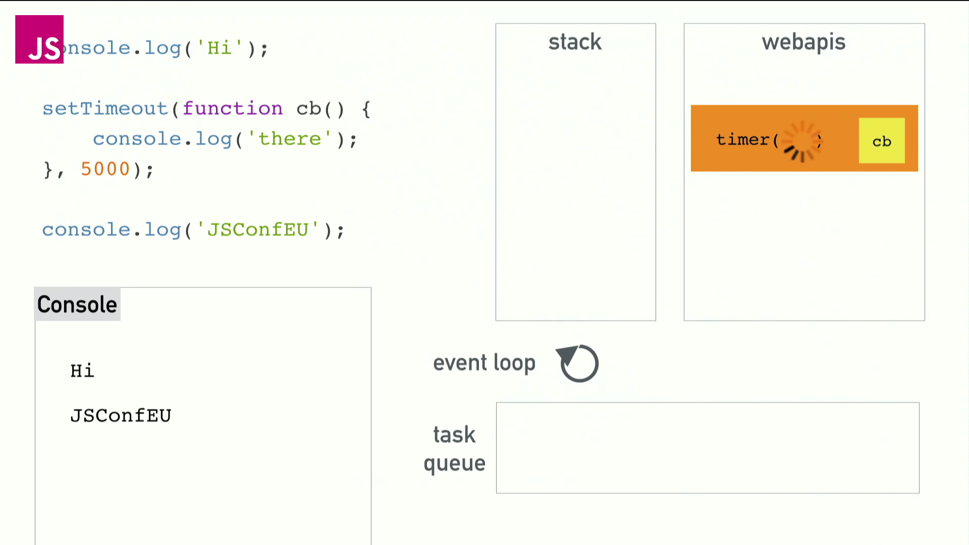
Web API

Slide 7
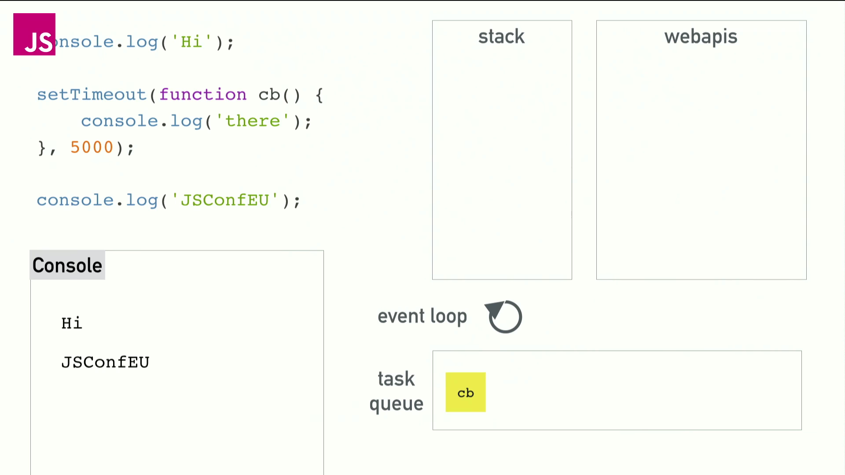
Callback / Task Queue

Slide 8
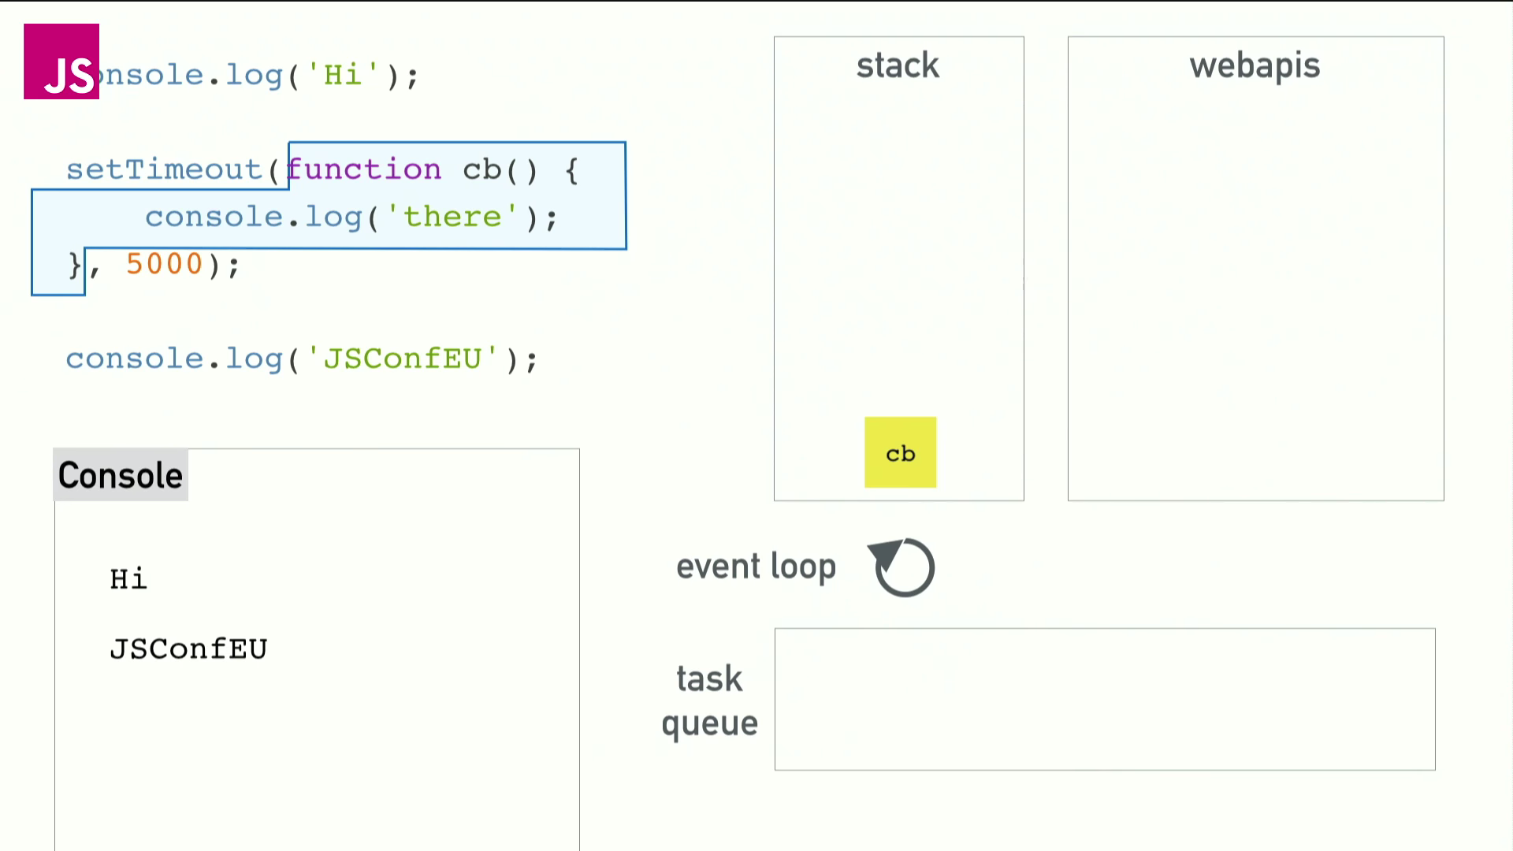
Event Loop

Slide 9
Best Event Loop Explanation Ever
https://www.youtube.com/watch?v=8aGhZQkoFbQ
Or Google: What the heck is the event loop anyway?
Highly recommend it

Slide 10
Callbacks
Why Callbacks?
We like to do something else instead of waiting.
JS is single threaded
It was convenient
People were lazy

Slide 11

What If We Didn’t Have Callbacks?
No asynchronous calls
Everything is synchronous
Who doesn’t like to wait and be blocked by something??

Slide 12
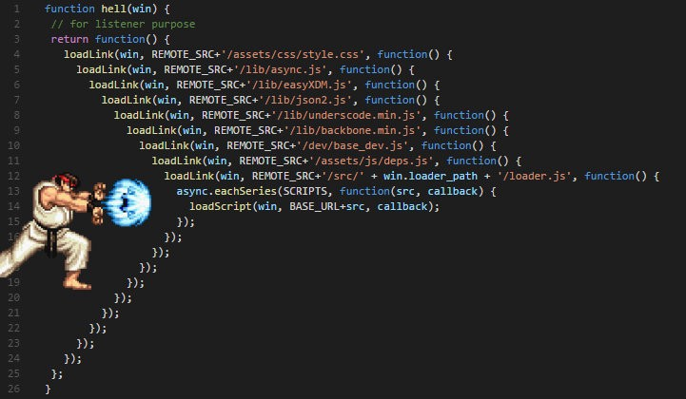
Callback Hell
You ask me what callback hell is? Well…

Slide 13
Promises
Here comes the Promise to save the world.
“The Promise object is used for deferred and asynchronous computations. A Promise represents an operation that hasn’t completed yet, but is expected in the future.” — MDN Promise Reference
Readable code
Paves way for Async/Await

Slide 14
Promise (Contd..)
Promise has 3 states:
Pending
Fulfilled
Rejected

Slide 15
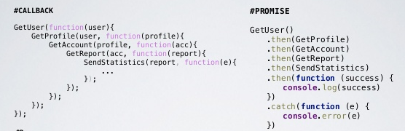
Callback VS Promise

Slide 16
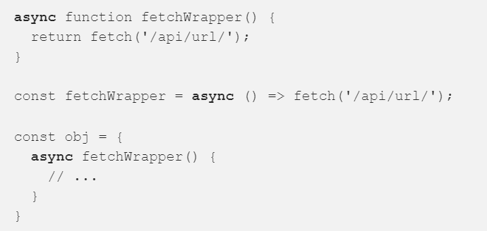
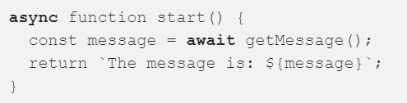
Async/Await
Finally. We are here. I “Promised”.
Async function is a function that returns a Promise.
Await is used on promise returning functions. Unwraps promises.

Slide 17
Why Async/Await?
Async/Await provides a way of writing synchronous looking code that actually executes asynchronously.
Intuituive error handling. try.. catch
Async/Await is purely based off of Promises.

Slide 18
How is Async/Await better?
No Callback Hell
Cleaner and better readable code
Usage of try..catch makes error handling more obvious for developers

Slide 19
What About Concurrency?
When you want to make calls that are not related to each other in any way.
Well, Promise.all([task1, task2, …]) to the rescue
Promise.all triggers calls one after the other without waiting for the previous call to finish and returns the result of all the calls in an array.

Slide 20
Browser Support
All the latest version of browsers
IE11 does not support async
Oh no, what do we do?
We use regenerator-runtime, babel-polyfill and transpilation to support async

Slide 21
References
https://medium.com/dailyjs/asynchronous-adventures-in-javascript-understanding-the-event-loop-fc6f968d5f72
https://medium.com/dailyjs/asynchronous-adventures-in-javascript-callbacks-39880f1b470e
https://medium.com/dailyjs/asynchronous-adventures-in-javascript-promises-1e0da27a3b4
https://medium.com/dailyjs/asynchronous-adventures-in-javascript-async-await-bd2e62f37ffd
https://www.youtube.com/watch?v=8aGhZQkoFbQ

Slide 22
Questions?

Slide 23
ThanK YOU!

